Slide 1


Data Structures II
Efi Arazi School of Computer Science
Introduction to Computer Science
Shimon Schocken
Lecture 10-2

Slide 2
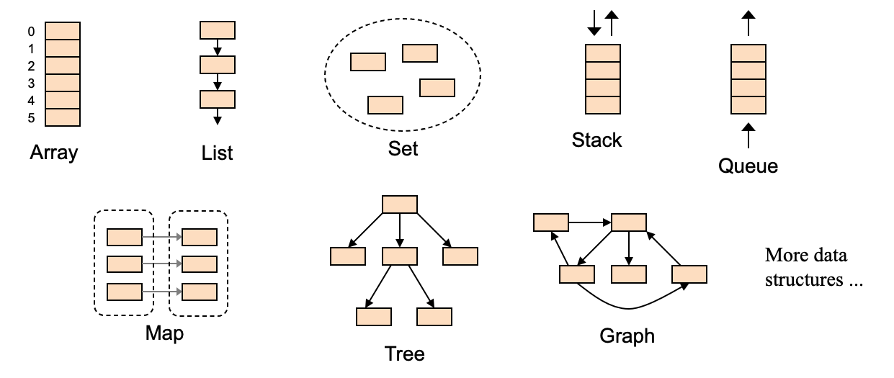
Data structures
Data structure: A way of organizing, processing, storing, and retrieving data. Different data structures are suited to different kinds of applications, and different kinds of efficiency.
All widely used in computer science
All can be implemented using arrays or lists

Slide 3
Data structures
Data structure: A way of organizing, processing, storing, and retrieving data. Different data structures are suited to different kinds of applications, and different kinds of efficiency.
previous lectures
All widely used in computer science
All can be implemented using arrays or lists

Slide 4
Data structures
Data structure: A way of organizing, processing, storing, and retrieving data. Different data structures are suited to different kinds of applications, and different kinds of efficiency.
this lecture
All widely used in computer science
All can be implemented using arrays or lists

Slide 5
Lecture plan
Set
Stack
Map
Methodology
Abstraction: How to use the data structure
Implementation: How to realize the data structure (using arrays / lists)

Slide 6
Set abstraction
What makes a collection of elements a set ?
No order
For example, {4, 3, 5} is considered the same set as {3, 4, 5}
No duplication
For example, {4, 3, 5, 4} is not a valid set; To make it a set, we must reduce it to {4, 3, 5}
Basic operations
Create an empty set
Create a set with given elements (uniquely)
Check if the set contains an element
Add an element (uniquely)
…
Set specific operations
Intersection
Union
Difference
…

Slide 7

Set abstraction
/** Represents a set of int values.
* A set is a collection of values without repetition or order.
* The set has an unlimited size. */
public class Set {
/** Constructs an empty set. */
public Set()
/** Checks if the given element exists in this set. */
public boolean contains(int e)
/** If the given element is not in this set, adds it to this set.
* Otherwise, does nothing. */
public void add(int e)
/** Creates a set containing the elements in the given array. */
public Set(int[] arr)
/** Creates a set containing the elements in the given set. */
public Set(Set set) {
/** Returns a set which is the union of this set and the other set. */
public Set union(Set other)
/** Returns a set which is the intersection of this set and the other set. */
public Set intersection(Set other) {
/** Returns a string representing this set in the form of
* {e1, e2, e3, ...}, where the e's are the set elements. */
public String toString()
...
}
API
Basic operations
Create an empty set
Create a set with given elements (uniquely)
Check if the set contains an element
Add an element (uniquely)
…
Set specific operations
Intersection
Union
Difference
…

Slide 8
Constructing sets
/** Represents a set of int values.
* A set is a collection of values without repetition or order.
* The set has an unlimited size. */
public class Set {
/** Constructs an empty set. */
public Set()
/** Checks if the given element exists in this set. */
public boolean contains(int e)
/** If the given element is not in this set, adds it to this set.
* Otherwise, does nothing. */
public void add(int e)
/** Creates a set containing the elements in the given array. */
public Set(int[] arr)
/** Creates a set containing the elements in the given set. */
public Set(Set set)
/** Returns a set which is the union of this set and the other set. */
public Set union(Set other)
/** Returns a set which is the intersection of this set and the other set. */
public Set intersection(Set other) {
/** Returns a string representing this set in the form of
* {e1, e2, e3, ...}, where the e's are the set elements. */
public String toString()
...
}
// Some class (client code)
Set s1 = new Set();
s1.add(3); s1.add(1); s1.add(3); s1.add(5); s1.add(7);
System.out.println("s1 = " + s1);
int[] data = {7, 9, 1, 9, 1, 7};
Set s2 = new Set(data);
System.out.println("s2 = " + s2);
Set s3 = new Set(s2);
System.out.println("s3 = " + s3);
API
// Output
s1 = {3, 1, 5, 7}
s2 = {7, 9, 1}
s3 = {7, 9, 1}
Let’s open the black box...

Slide 9

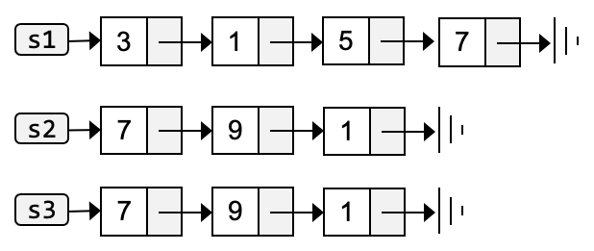
Set constructors
/** Represents a set of int values.
* A set is a collection of values without repetition or order.
* The set has an unlimited size. */
public class Set {
private List elements; // The elements of this set
/** Constructs an empty set. */
public Set() {
elements = new List();
}
...
// Some class (client code)
Set s1 = new Set();
Note
In this implementation, Set objects are implemented using List objects
Behind-the-scene implementation:

Slide 10
Adding elements (uniquely)
/** Represents a set of int values.
* A set is a collection of values without repetition or order.
* The set has an unlimited size. */
public class Set {
private List elements; // The elements of this set
/** Constructs an empty set. */
public Set() {
elements = new List();
}
/** Checks if the given element exists in this set. */
public boolean contains(int e) {
return (elements.indexOf(e) > -1);
}
/** If the given element is not in this set, adds it to this set.
* Otherwise, does nothing. */
public void add(int e) {
if (!contains(e)) {
elements.add(e);
}
}
...
// Some class (client code)
Set s1 = new Set();
s1.add(3); s1.add(1); s1.add(3); s1.add(5); s1.add(7);
System.out.println("s1 = " + s1);
// Output
s1 = {3, 1, 5, 7}
Behind-the-scene implementation:

Slide 11
Set constructors
/** Represents a set of int values.
* A set is a collection of values without repetition or order.
* The set has an unlimited size. */
public class Set {
private List elements; // The elements of this set
/** Constructs an empty set. */
public Set()
/** Checks if the given element exists in this set. */
public boolean contains(int e)
/** If the given element is not in this set, adds it to this set.
* Otherwise, does nothing. */
public void add(int e)
/** Creates a set containing the elements in the given array. */
public Set(int[] arr) {
this();
// Iterates over the given array and adds its elements to this set
for (int e : arr) {
add(e);
}
}
...
// Some class (client code)
Set s1 = new Set();
s1.add(3); s1.add(1); s1.add(3); s1.add(5); s1.add(7);
System.out.println("s1 = " + s1);
int[] data = {7, 9, 1, 9, 1, 7};
Set s2 = new Set(data);
System.out.println("s2 = " + s2);
// Output
s1 = {3, 1, 5, 7}
s2 = {7, 9, 1}
Behind-the-scene implementation:

Slide 12
Aside: For Each (built-in Java iterator)
/** Represents a set of int values.
* A set is a collection of values without repetition or order.
* The set has an unlimited size. */
public class Set {
private List elements; // The elements of this set
/** Constructs an empty set. */
public Set()
/** Checks if the given element exists in this set. */
public boolean contains(int e)
/** If the given element is not in this set, adds it to this set.
* Otherwise, does nothing. */
public void add(int e)
/** Creates a set containing the elements in the given array. */
public Set(int[] arr) {
this();
// Iterates over the given array and adds its elements to this set
for (int e : arr) {
add(e);
}
}
...
// Iterates over the array elements
for (int e : arr) {
process(e);
}
Same as:
// Iterates over the array elements
for (int i = 0; i < arr.length; i++) {
process(arr[i]);
}
The for-each rules:
The loop must iterate over all the elements
The statements in the body of the loop cannot refer to specific elements
The loop cannot modify the elements
Can be used for any iterable collection, not only arrays (more details, later).
Best practice
For-each is elegant and readable. Whenever possible, use it!

Slide 13
Set constructors
/** Represents a set of int values.
* A set is a collection of values without repetition or order.
* The set has an unlimited size. */
public class Set {
private List elements; // The elements of this set
/** Constructs an empty set. */
public Set()
/** Checks if the given element exists in this set. */
public boolean contains(int e)
/** If the given element is not in this set, adds it to this set.
* Otherwise, does nothing. */
public void add(int e)
...
/** Creates a set containing the elements in the given set. */
public Set(Set set) {
this();
// Iterates over the given set and adds its elements to this set
ListIterator itr = set.elements.listIterator();
while (itr.hasNext()) {
int e = itr.next();
add(e);
}
}
...
// Some class (client code)
Set s1 = new Set();
s1.add(3); s1.add(1); s1.add(3); s1.add(5); s1.add(7);
System.out.println("s1 = " + s1);
int[] data = {7, 9, 1, 9, 1, 7};
Set s2 = new Set(data);
System.out.println("s2 = " + s2);
Set s3 = new Set(s2);
System.out.println("s3 = " + s3);
// Output
s1 = {3, 1, 5, 7}
s2 = {7, 9, 1}
s3 = {7, 9, 1}

Slide 14
Set constructors
/** Represents a set of int values.
* A set is a collection of values without repetition or order.
* The set has an unlimited size. */
public class Set {
private List elements; // The elements of this set
/** Constructs an empty set. */
public Set()
/** Checks if the given element exists in this set. */
public boolean contains(int e)
/** If the given element is not in this set, adds it to this set.
* Otherwise, does nothing. */
public void add(int e)
...
/** Creates a set containing the elements in the given set. */
public Set(Set set) {
this();
// Iterates over the given set and adds its elements to this set
ListIterator itr = set.elements.listIterator();
while (itr.hasNext()) {
int e = itr.next();
add(e);
}
}
...
Can we use this code instead?
// Iterates over the given set...
for (int e : set.elements) {
add(e);
}
Yes!
To do so, we must make the List class iterable (details later).

Slide 15
Set operations: Union
/** Represents a set of int values.
* A set is a collection of values without repetition or order.
* The set has an unlimited size. */
public class Set {
private List elements; // The elements of this set
/** Constructs an empty set. */
public Set()
/** Checks if the given element exists in this set. */
public boolean contains(int e)
/** If the given element is not in this set, adds it to this set.
* Otherwise, does nothing. */
public void add(int e)
/** Creates a set containing the elements in the given set. */
public Set(Set set)
/** Returns a set which is the union of this set and the other set. */
public Set union(Set other) {
// Creates a result set with the elements of this set
Set result = new Set(this);
// Iterates over the other set and adds it elements to the result set
ListIterator itr = other.elements.listIterator();
while (itr.hasNext()) {
int e = itr.next();
result.add(e);
}
return result;
}
...
}
// Some class (client code)
Set s1 = new Set();
s1.add(3); s1.add(1); s1.add(3); s1.add(5); s1.add(7);
System.out.println("s2 = " + s2);
int[] data = {7, 9, 1, 9, 1, 7};
Set s2 = new Set(data);
System.out.println("s2 = " + s2);
System.out.println(s1.union(s2));
// Output
S1 = {3, 1, 5, 7}
S2 = {7, 9, 1}
{3, 1, 5, 7, 9} // Union

Slide 16
Set operations: Intersection
/** Represents a set of int values.
* A set is a collection of values without repetition or order.
* The set has an unlimited size. */
public class Set {
private List elements; // The elements of this set
/** Constructs an empty set. */
public Set()
/** Checks if the given element exists in this set. */
public boolean contains(int e)
/** If the given element is not in this set, adds it to this set.
* Otherwise, does nothing. */
public void add(int e)
/** Creates a set containing the elements in the given set. */
public Set(Set set)
/** Returns a set which is the intersection of this set and the other set. */
public Set intersection(Set other) {
// Creates an empty result set
Set result = new Set();
// For each element in this set, if it exists in the other set,
// adds the element to the result set
ListIterator itr = elements.listIterator();
while (itr.hasNext()) {
int e = itr.next();
if (other.contains(e)) {
result.add(e);
}
}
return result;
}
...
// Some class (client code)
Set s1 = new Set();
s1.add(3); s1.add(1); s1.add(3); s1.add(5); s1.add(7);
System.out.println("s2 = " + s2);
int[] data = {7, 9, 1, 9, 1, 7};
Set s2 = new Set(data);
System.out.println("s2 = " + s2);
System.out.println(s1.union(s2));
System.out.println(s1.intersection(s2));
// Output
S1 = {3, 1, 5, 7}
S2 = {7, 9, 1}
{3, 1, 5, 7, 9} // Union
{1, 7} // Intersection

Slide 17
Set: Recap
/** Represents a set of int values.
* A set is a collection of values without repetition or order.
* The set has an unlimited size. */
public class Set {
/** Constructs an empty set. */
public Set()
/** Checks if the given element exists in this set. */
public boolean contains(int e)
/** If the given element is not in this set, adds it to this set.
* Otherwise, does nothing. */
public void add(int e)
/** Creates a set containing the elements in the given array. */
public Set(int[] arr)
/** Creates a set containing the elements in the given set. */
public Set(Set set) {
/** Returns the union of this set and the other set. */
public Set union(Set other)
/** Returns the intersection of this set and the other set. */
public Set intersection(Set other) {
/** Returns a string representing this set in the form of
* {e1, e2, e3, ...}, where the e's are the set elements. */
public String toString()
...
}
API
Using the Set class, any client program can create and manipulate sets;
The Set API provides a “domain language” for handling sets;
OOP is an excellent tool for building domain languages, for numerous domains.
Big problem, Big solution
The List class, as defined, can handle only int values. Therefore, any class that depends on it, like Set, can also handle only int values.
Can we make List, and any class that depends on it, handle objects of any type?
Yes!
To do so, we must make them generic classes (details later).

Slide 18
Lecture plan
Set
Stack
Map

Slide 19
Lecture plan
Set
Stack
Map
Methodology
Abstraction: How to use a stack
Implementation: How to realize a stack (using an array)

Slide 20
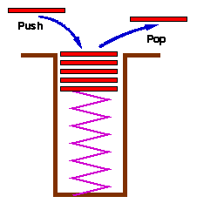
Stack
An ordered collection of elements, with a single entry / exit point
Elements are pushed (added) onto the stack’s top
Elements are popped (removed) from the stack’s top
// Arbitrary stack operation examples:
create an empty stack [ ]
push 3 [ 3 ]
push 7 [ 3, 7 ]
push 6 [ 3, 7, 6 ]
push 8 [ 3, 7, 6, 8 ]
push 2 [ 3, 7, 6, 8, 2 ]
x = pop // x = 2 [ 3, 7, 6, 8 ]
y = pop // y = 8 [ 3, 7, 6 ]
push 4 [ 3, 7, 6, 4 ]
add // addition [ 3, 7, 10 ]
neg // negation [ 3, 7, -10 ]
...
Last In, First Out (LIFO)
Stack: A fundamental data structure, used in numerous applications in the theory and practice of CS

Slide 21
Stack abstraction
/** Represents a stack of integers, with stack arithmetic. */
public class Stack {
/** Constructs an empty stack. */
public Stack()
/** Pushes the given element onto the stack's top. */
public void push(int e)
/** Removes and returns the stack's top element */
public int pop()
/** Checks if this stack is empty. */
public boolean isEmpty()
/** Stack-oriented addition: Pops the two top elements,
* adds them up, and pushes the result onto the stack */
public void add()
/** Similar arithmetic operations follow: subtract, multiply... */
...
/** Stack-oriented negation: Pops the top element, negates it,
* and pushes the result onto the stack */
public void neg()
/** Returns a string representing this stack, in the form of [e1, e2, e3, ...],
* where the e's are the stack elements. */
public String toString()
}
API
// Some class (client code)
Stack stack = new Stack();
stack.push(10); stack.push(20); stack.push(30); stack.push(40); stack.push(50);
System.out.println("Stack: " + stack);
int x = stack.pop();
System.out.println("After pop(): " + stack);
x = stack.pop();
System.out.println("After pop(): " + stack);
stack.add();
System.out.println("After add(): " + stack);
// Output
Stack: [10, 20, 30, 40, 50]
After pop: [10, 20, 30, 40]
After pop: [10, 20, 30]
After add: [10, 50]

Slide 22
Constructing a stack
/** Represents a stack of integers. */
public class Stack {
// The default capacity of this stack
private final static int MAX_SIZE = 100;
// The elements of this stack
private int[] elements = new int[MAX_SIZE];
// The location in this stack just following the stack's top element.
private int top;
/** Constructs a stack with the default size. */
public Stack() {
top = 0;
}
// Some class (client code)
Stack stack = new Stack();
Implementation of
constructing a stack:
top
0
1
2
3
4
. . .
99

Slide 23
Pushing / Popping elements
/** Represents a stack of integers. */
public class Stack {
// The default capacity of this stack
private final static int MAX_SIZE = 100;
// The elements of this stack
private int[] elements = new int[MAX_SIZE];
// The location in this stack just following the stack's top element.
private int top;
/** Constructs a stack with the default size. */
public Stack() {
top = 0;
}
/** Pushes the given element onto the stack. */
public void push(int e) {
elements[top++] = e;
}
// Some class (client code)
Stack stack = new Stack();
stack.push(10); stack.push(20); stack.push(30); System.out.println("Stack: " + stack);
// Output (abstraction)
Stack: [10, 20, 30]
Implementation of
stack.push(30):
0
10
0
10
1
20
1
20
top
30
2
2
3
top
3
4
4
. . .
. . .
99
99
before
after

Slide 24
Pushing / Popping elements
/** Represents a stack of integers. */
public class Stack {
// The default capacity of this stack
private final static int MAX_SIZE = 100;
// The elements of this stack
private int[] elements = new int[MAX_SIZE];
// The location in this stack just following the stack's top element.
private int top;
/** Constructs a stack with the default size. */
public Stack() {
top = 0;
}
/** Pushes the given element onto the stack. */
public void push(int e) {
elements[top++] = e;
}
/** Removes and returns the stack's top element */
public int pop() {
return elements[--top];
}
// Some class (client code)
Stack stack = new Stack();
stack.push(10); stack.push(20); stack.push(30); System.out.println("Stack: " + stack);
int x = stack.pop();
System.out.println("After pop(): " + stack);
x = stack.pop();
System.out.println("After pop(): " + stack);
// Output (abstraction)
Stack: [10, 20, 30]
After pop: [10, 20]
After pop: [10]
Implementation of (the first)
stack.pop():
0
10
0
10
1
20
1
20
2
30
top
30
2
top
3
3
4
4
. . .
. . .
99
99
before
after

Slide 25
Stack arithmetic
/** Represents a stack of integers, with stack arithmetic. */
public class Stack {
/** Constructs an empty stack. */
public Stack()
/** Pushes the given element onto the stack's top. */
public void push(int e)
/** Removes and returns the stack's top element */
public int pop()
...
/** Stack-oriented addition: Pops the two top elements,
* adds them up, and pushes the result onto the stack */
public void add()
/** Stack-oriented negation: Pops the top element, negates it,
* and pushes the result onto the stack */
public void neg()
/** More stack arithmetic operations: subtract, multiply... */
...
// Some class (client code)
Stack stack = new Stack();
stack.push(10); stack.push(20); stack.push(30);
stack.add();
System.out.println("After add: " + stack);
stack.neg();
System.out.println("After neg: " + stack);
API
// Output
Stack: [10, 20, 30]
After add: [10, 50]
After neg: [10, -50]

Slide 26
Stack arithmetic
/** Represents a stack of integers, with stack arithmetic. */
public class Stack {
/** Constructs an empty stack. */
public Stack()
/** Pushes the given element onto the stack's top. */
public void push(int e)
/** Removes and returns the stack's top element */
public int pop()
...
/** Stack-oriented addition: Pops the two top elements,
* adds them up, and pushes the result onto the stack */
public void add() {
push(pop() + pop());
}
/** Negation, similar stack-oriented operation */
public void neg() {
push(-1 * pop());
}
...
// Some class (client code)
Stack stack = new Stack();
stack.push(10); stack.push(20); stack.push(30);
stack.add();
System.out.println("After add: " + stack);
stack.neg();
System.out.println("After neg: " + stack);
// Output
Stack: [10, 20, 30]
After add: [10, 50]
After neg: [10, -50]

Slide 27
Aside 1: toString(), using a StringBuilder technique
/** Represents a stack of integers. */
public class Stack {
// The capacity of this stack
private final static int MAX_SIZE = 100;
// The elements of this stack
private int[] elements = new int[MAX_SIZE];
// The location in this stack just following the stack's top element.
private int top;
...
/** Returns a string representing this stack, in the form of [e1, e2, e3, ...],
* where the e's are the stack elements. */
public String toString() {
if (top == 0) {
return "[]";
}
// Uses a StringBuilder to build the string, which is less wasteful
// then using s = s + elements[i]
StringBuilder s = new StringBuilder("[");
for (int i = 0; i < (top - 1); i++) {
s.append(elements[i] + ", ");
}
return s.append(elements[top - 1] +
"]").toString();
}
...
// Some class (client code)
Stack stack = new Stack();
stack.push(10); stack.push(20); stack.push(30); stack.push(40); stack.push(50);
System.out.println("Stack: " + stack);
// Output
Stack: [10, 20, 30, 40, 50]
General comment: String processing
StringBuilder is a Java class that represents mutable sequences of characters. Helps reduce the number of temporary string objects created when performing frequent string manipulations.
Unlike String objects, which are immutable, StringBuilder objects can be changed through operations like append, insert, or delete.
Best practice
When building a sequence of characters which is potentially large, use a StringBuilder object.

Slide 28
Aside 2: Featuring unlimited capacity
/** Represents a stack of integers. */
public class Stack {
// The capacity of this stack
private final static int MAX_SIZE = 100;
// The elements of this stack
private int[] elements = new int[MAX_SIZE];
// The location in this stack just following the stack's top element.
private int top;
...
/** Pushes the given element onto the stack's top. */
public void push(int e) {
elements[top++] = e;
}
...
// Some class (client code)
Stack stack = new Stack();
// Can potentially lead to stack overflow:
stack.push(10); stack.push(20); stack.push(30); stack.push(40); stack.push(50); ...
...
Here we increment top without checking if it reached capacity

Slide 29
Aside 2: Featuring unlimited capacity
/** Represents a stack of integers. */
public class Stack {
// The capacity of this stack
private final static int MAX_SIZE = 100;
// The elements of this stack
private int[] elements = new int[MAX_SIZE];
// The location in this stack just following the stack's top element.
private int top;
...
/** Pushes the given element onto the stack's top. */
public void push(int e) {
if (top == elements.length - 1) {
resize();
}
elements[top++] = e;
}
// Doubles the stack's capacity. */
private void resize() {
int[] newElements = new int[elements.length * 2];
// Copies elements.size elements from location 0 in elements
// to newElements, starting at location 0.
System.arraycopy(elements, 0, newElements, 0,
elements.length);
elements = newElements;
}
...
// Some class (client code)
Stack stack = new Stack();
// Can potentially lead to stack overflow:
stack.push(10); stack.push(20); stack.push(30); stack.push(40); stack.push(50);
...
Handling unlimited capacity
When the stack reaches capacity, we double the capacity
Best practice
Similar techniques can be used to feature an unlimited capacity for any data structure that uses an array implementation.

Slide 30



Stack application examples
Browsing
The URL’s that the user visits are pushed onto a stack;
When clicking “back”, a pop operation returns the page that was visited last before the current one
Editing
The user’s editing operations are pushed onto a stack;
When clicking “undo”, the most recent operation is popped and undone
Compilation
Simplifying the compilation task

Slide 31
Compilation (Java, Python, C#)
Prog.java
Prog.bin
7 * (4 + 2) / (5 – 3)
1100101001011011
0001010100011001
1000101001000010
1100100001000011
0000101001011000
1000101011011010
0000101001011000
0100101001011010
1100101001011011
1100100001000011
0000101001011000
...
Compilation
The challenge
Breaking the compilation task into independent and modular steps
Executable code

Slide 32
Compilation (Java, Python, C#)
Prog.java
Prog.class
Prog.bin
7 * (4 + 2) / (5 – 3)
push 7
push 4
push 2
add
mult
push 5
push 3
sub
div
1100101001011011
0001010100011001
1000101001000010
1100100001000011
0000101001011000
1000101011011010
0000101001011000
0100101001011010
1100101001011011
1100100001000011
0000101001011000
...
javac Prog.java
java Prog
parser
/
code generator
translator
*
–
7
+
5
3
4
2
Source code
Parse tree
Bytecode
Executable code
Relevant algorithms (covered in more advanced CS courses)
Parsing source code into a parse tree
Generating stack commands from a parse tree
Translating stack commands into machine language instructions

Slide 33
Lecture plan
Set
Stack
Map

Slide 34
Lecture plan
Set
Stack
Map
Methodology
Abstraction: How to use a map
Implementation: How to realize a map (using arrays and lists)

Slide 35
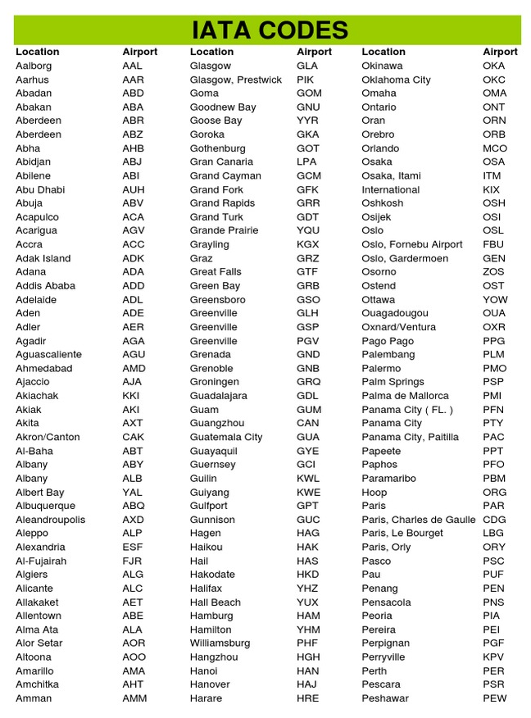
Map
40,000+ listed airports

Slide 36
Map
Map: a set of <key, value> pairs
(<"TLV", "Tel Aviv">, <"MUM", "Mumbai">, …)
key
value
TLV
MUM
LON
NYC
...
Tel Aviv
Mumbai
London
New York
...
40,000+ listed airports
Objective: Given a key, get its value, fast
HashMap: A data structure designed to support this requirement

Slide 37


Map
Map: a set of <key, value> pairs
(<"Cow", "Moo">, <"Dog", "Woof">, …)
key
value
Cow
Dog
Mouse
Cat
...
Moo
Woof
Squeek
Miao
...
Another example
Animals, and sounds
moo
woof
Objective: Given a key, get its value, fast
HashMap: A data structure designed to support this requirement

Slide 38
Map
Map: a set of <key, value> pairs
(<"Cow", "Moo">, <"Dog", "Woof">, …)
key
value
Cow
Dog
Mouse
Cat
...
Moo
Woof
Squeek
Miao
...
Another example
Animals, and sounds
moo
woof
Why is this a serious example?
For example, suppose you are creating a computer game, for children;
The game has many animals. You want to associate each animal with a .wav file that makes its sound;
What we’ll show now can be trivially changed to implement this requirement.

Slide 39
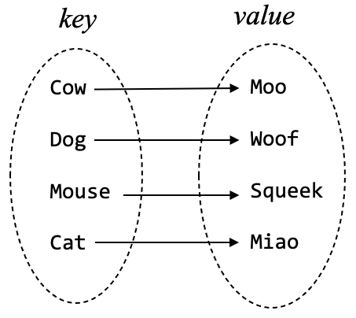
HashMap: Usage
/** Represents a mapping of String keys to String values. */
public class HashMap {
/** Constructs a new HashMap. */
public HashMap()
/** Associates the given value with the given key. If this map
* already contains the given key, the old value is replaced. */
public void put(String key, String value)
/** Returns the value to which the given key is mapped.
* If this map does not contain the given key, returns null. */
public String get(String key)
/** Returns all the values contained in this map, as a list. */
public List<String> values()
/** Returns all the keys contained in this map, as a list. */
public List<String> keySet()
}
// Client code (example)
// Constructs a map of < String , String > pairs
HashMap animalSound = new HashMap();
// Puts some < String , String > pairs in the map
animalSound.put("dog", "woof");
animalSound.put("cat", "miao");
animalSound.put("cow", "moo");
animalSound.put("mouse", "squeak");
// Prints some animals, and their sounds.
System.out.println("Cow goes " +
animalSound.get("cow"));
System.out.println("Mouse goes " +
animalSound.get("mouse"));
...
API
cow goes moo
mouse goes squeak

Slide 40
HashMap: Usage
/** Represents a mapping of String keys to String values. */
public class HashMap {
/** Constructs a new HashMap. */
public HashMap()
/** Associates the given value with the given key. If this map
* already contains the given key, the old value is replaced. */
public void put(String key, String value)
/** Returns the value to which the given key is mapped.
* If this map does not contain the given key, returns null. */
public String get(String key)
/** Returns all the values contained in this map, as a list. */
public List<String> values()
/** Returns all the keys contained in this map, as a list. */
public List<String> keySet()
}
// Client code (continues from last slide)
// Iterates over, and prints, the animal sounds
for (String sound : animalSound.values()) {
System.out.println(sound);
}
API
squeak
miao
moo
woof
List<String>: A List class that handles String objects.
List<type> is a generic List class that handles lists of any object type, (unlike the List class from lecture 8-1, that handles only int values);
More about generic classes: Lecture 9-2.

Slide 41
HashMap: Usage
/** Represents a mapping of String keys to String values. */
public class HashMap {
/** Constructs a new HashMap. */
public HashMap()
/** Associates the given value with the given key. If this map
* already contains the given key, the old value is replaced. */
public void put(String key, String value)
/** Returns the value to which the given key is mapped.
* If this map does not contain the given key, returns null. */
public String get(String key)
/** Returns all the values contained in this map, as a list. */
public List<String> values()
/** Returns all the keys contained in this map, as a list. */
public List<String> keySet()
}
// Client code (continues from last slide)
// Iterates over, and prints, the animal sounds
for (String sound : animalSound.values()) {
System.out.println(sound);
}
// Iterates over the animals in the map;
// For each animal, prints the animal and its sound.
for (String animal : animalSound.keySet()) {
// Gets the sound associated with this animal
String sound = animalSound.get(animal);
// Prints the animal and its sound
System.out.println(animal + " goes " + sound);
}
...
API
squeak
miao
moo
woof
dog goes woof
cat goes miao
cow goes moo
mouse goes squeak
List<String>: A List class that handles String objects.
List<type> is a generic List class that handles lists of any object type, (unlike the List class from lecture 8-1, that handles only int values);
More about generic classes: Lecture 9-2.

Slide 42
HashMap: Usage
/** Represents a mapping of String keys to String values. */
public class HashMap {
/** Constructs a new HashMap. */
public HashMap()
/** Associates the given value with the given key. If this map
* already contains the given key, the old value is replaced. */
public void put(String key, String value)
/** Returns the value to which the given key is mapped.
* If this map does not contain the given key, returns null. */
public String get(String key)
/** Returns all the values contained in this map, as a list. */
public List<String> values()
/** Returns all the keys contained in this map, as a list. */
public List<String> keySet()
}
// Client code (continues from last slide)
// Iterates over, and prints, the animal sounds
for (String sound : animalSound.values()) {
System.out.println(sound);
}
// Iterates over the animals in the map;
// For each animal, prints the animal and its sound.
for (String animal : animalSound.keySet()) {
// Gets the sound associated with this animal
String sound = animalSound.get(animal);
// Prints the animal and its sound
System.out.println(animal + " goes " + sound);
}
...
API
squeak
miao
moo
woof
dog goes woof
cat goes miao
cow goes moo
mouse goes squeak
Why is this a serious example?
The String that represents the animal sound can represent the name of a .wav file
To make this program ”sing and dance”, we make a tiny change in the client code: Instead of printing the sound, we call a method like playWavFile(filename).

Slide 43
HashMap: implementation
key value
63 9
321 6
3 573
7009 16
143 8
2
...
Comment
We’ll illustrate how to implement a HashMap that manages pairs of <integer, integer>;
We’ll comment later how to generalize this approach to implement any mapping.

Slide 44
HashMap: implementation
Map
key value
0
63 9
321 6
3 573
7009 16
143 8
2
...
1
h(key) =
key % 10 =
2
Array of linked lists
. . .
3
...
9
N = 10

Slide 45
HashMap: implementation
Map
key value
0
63 9
321 6
3 573
7009 16
143 8
2
...
1
h(key) =
key % 10 =
2
. . .
3
63
9
...
9
N = 10

Slide 46
HashMap: implementation
Map
key value
0
63 9
321 6
3 573
7009 16
143 8
2
...
1
h(key) =
key % 10 =
2
. . .
3
63
9
...
9
N = 10

Slide 47
HashMap: implementation
Map
key value
0
63 9
321 6
3 573
7009 16
143 8
2
...
1
321
6
h(key) =
key % 10 =
2
. . .
3
63
9
...
9
N = 10

Slide 48
HashMap: implementation
Map
key value
0
63 9
321 6
3 573
7009 16
143 8
2
...
1
321
6
h(key) =
key % 10 =
2
. . .
3
63
9
...
9
N = 10

Slide 49
HashMap: implementation
Map
key value
0
63 9
321 6
3 573
7009 16
143 8
2
...
1
321
6
h(key) =
key % 10 =
2
. . .
3
63
9
3
573
...
9
N = 10

Slide 50
HashMap: implementation
Map
key value
0
63 9
321 6
3 573
7009 16
143 8
2
...
1
321
6
h(key) =
key % 10 =
2
. . .
3
63
9
3
573
...
9
N = 10

Slide 51
HashMap: implementation
Map
key value
0
63 9
321 6
3 573
7009 16
143 8
2
...
1
321
6
h(key) =
key % 10 =
2
. . .
3
63
9
3
573
...
9
7009
16
N = 10

Slide 52
HashMap: implementation
Map
key value
0
63 9
321 6
3 573
7009 16
143 8
2
...
1
321
6
h(key) =
key % 10 =
2
. . .
3
63
9
3
573
...
9
7009
16
N = 10

Slide 53
HashMap: implementation
Map
key value
0
63 9
321 6
3 573
7009 16
143 8
2
...
1
321
6
h(key) =
key % 10 =
2
. . .
3
63
9
3
573
143
8
...
9
7009
16
N = 10

Slide 54
HashMap: implementation
Map
key value
0
63 9
321 6
3 573
7009 16
143 8
2
...
1
321
6
h(key) =
key % 10 =
2
. . .
3
63
9
3
573
143
8
...
9
7009
16
N = 10

Slide 55
HashMap: implementation
Map
key value
0
63 9
321 6
3 573
7009 16
143 8
2
...
1
321
6
11
2
h(key) =
key % 10 =
2
. . .
3
63
9
3
573
143
8
...
9
7009
16
N = 10

Slide 56
HashMap: implementation
Map
key value
0
63 9
321 6
3 573
7009 16
143 8
2
...
1
321
6
11
2
h(key) =
key % 10 =
2
. . .
3
63
9
3
573
143
8
...
9
7009
16
N = 10
put(key , value)
Compute h(key)
Add a node to the list
O (1)
get(key)
Compute h(key)
Search the list
O (n), where n is the longest list
Why hash tables are attractive
The map designer controls n:
The larger is the array size, the smaller is n
A large array is just fine: Accessing array elements is O (1).

Slide 57
HashMap: implementation
Map
key value
0
63 9
321 6
3 573
7009 16
143 8
2
...
1
321
6
11
2
h(key) =
key % 10 =
2
. . .
3
63
9
3
573
143
8
...
9
7009
16
N = 10
Important endnote
We showed a technique for implementing a HashMap that manages pairs of <integer, integer>;
In computers, all objects are, at bottom, numbers;
Therefore, what we showed applies to a HashMap of any <someObjectType, someOtherObjectType>
In other words, we showed a technique for representing, super efficiently, any mapping from any set to any set.

Slide 58
Data Structures II
Efi Arazi School of Computer Science
Introduction to Computer Science
Shimon Schocken
Lecture 10-2

